Slide 1
Business Process Engineering
Introduction to Business Process & BPE
Lecture: 01
Instructor: Salman Ahmad

Slide 2
Topics To Cover
Business Process
Components of Business Process
Business Process Lifecycle
Business Process Modeling
Process Analysis and Redesign
Process Automation
Lean Processes
Business Process Outsourcing

Slide 3
What is Business Process
Collection of related events, activities and decisions, that involve a number of actors, resources, and collectively lead to an outcome that is of value to organization or its customers

Slide 4
Types of Business Processes
Order-to-Cash
Procure-to-Pay
Application-to-Approval
Claim-to-Settlement
Fault-to-Resolution

Slide 5
Actors
Human actors, organizations, or software systems acting on behalf of human actors and organizations
Physical Objects
Equipment's, materials, products, documents
Information Objects
Electronic data and records

Slide 6


My TV won’t work
Warranty?
Call Center
Technician
Service Dispatch
Parts Store
Customer
Customer
VALUE

Slide 7
Processes & Outcomes
Every process leads to one or several outcomes, positive or negative
Positive outcomes deliver value
Negative outcomes reduces value
Fault-to-Resolution Process
Fault repaired w/o technician intervention
Fault repaired with minor technician intervention
Fault repaired & fully covered by warranty
Fault repaired and partly covered by warranty
Fault repaired w/o warranty cover
Fault not repaired
Notes:
Please explain?
Discuss the example of the Titanic and why the rafts were never thought of something else?

Slide 8
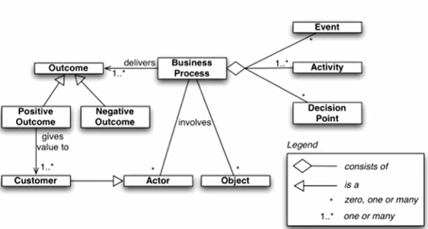
What is a Business Process

Slide 9
If it does not make at least 3 people mad, it is not a process
Hammer & Stanton (1995)

Slide 10
Business Process Management
The principles, methods and tools to design, analyze, execute and monitor business processes

Slide 11
The first rule of any technology used in a business is that automation applied to an efficient operation will magnify the efficiency. The second is that automation applied to an inefficient operation will magnify the inefficiency
Bill Gates

Slide 12
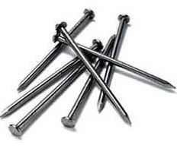
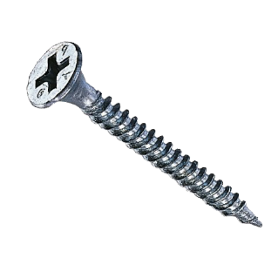
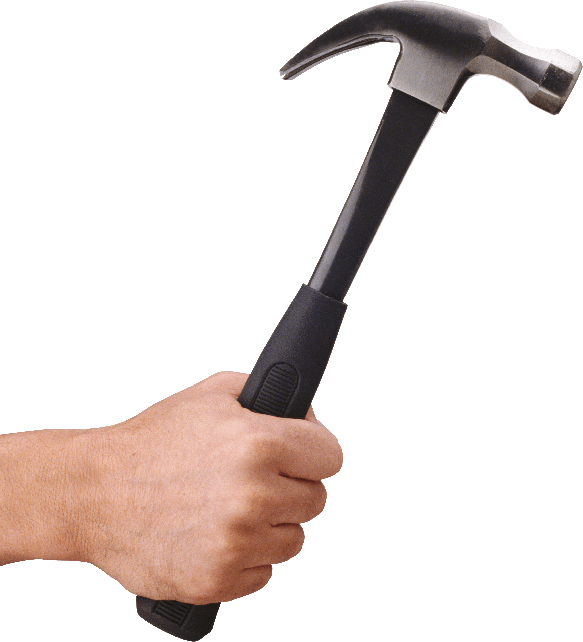

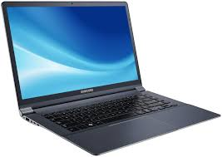
BPM is a tool – use wisely

Slide 13
Ford Case Study (Hammer 1900)
Ford needed to review its procurement process to:
Do it cheaper
Do it faster
Do it better
Account payable in North America employed > 500 people and turnaround times for processing POs and invoices was in the order of weeks

Slide 14
Fords Case Study
Automation would bring help (20% improvement)
Ford decided not to do it, Why?
Technology needed to the automation was not yet available
No one at Ford knew how to develop the technology needed to automate
There were not enough computers and computer literate employees at ford
None
Notes:
Solan applied division on labor on organization where as Ford applied it on manufacturing

Slide 15
Fords Case Study
Correct answers is Mazda’s Accounts Payable Department
Mazda had only six people handling it

Slide 16
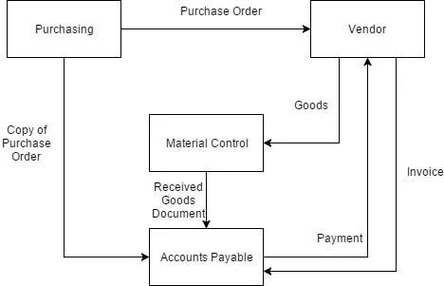
How process worked (as is)

Slide 17
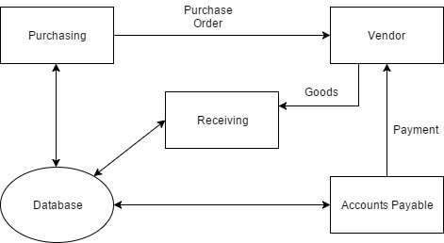
Reengineering Process (to be)
Notes:
Nothing is constant or predictable—not market growth, customer
demand, product life cycles, the rate of technological change, or the
nature of competition.

Slide 18
The result
75% reduction in head count
Material control is simpler
Financial information is accurate
Purchase requisition is faster
Less overdue payments
Notes:
Why automate something we do not need to do? Automate things that need to be done

Slide 19
Principles of BPR
Capture information once and at the source
Subsume information processing work into the real work that produces the information
Have those who use the output of the process drive the process
Treat geographically dispersed resources as if they were centralized

Slide 20
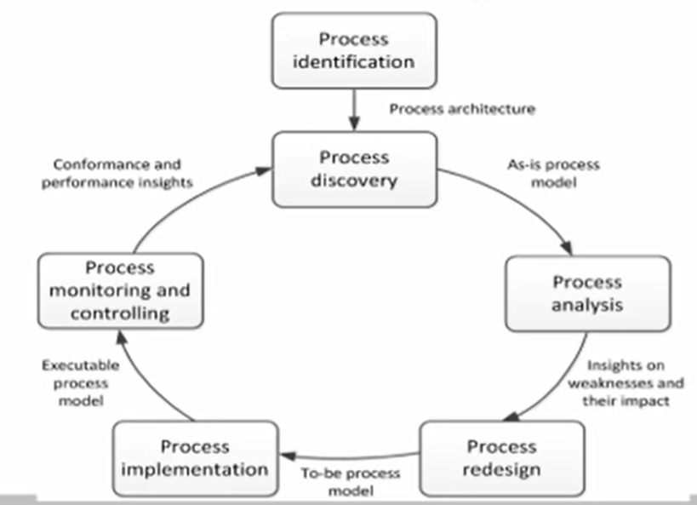
How to engage in BPM?

